Slide 1
By Team:- The Pulverizers

Slide 2


Slide 3


Slide 4

Problems faced by women
Women have been always under shadowed against men dowry
In past years women were just used a toy to give birth to a child
Women were not given respect , education and importance.
Sati..
Child marriges…
Illiteracy…

Slide 5
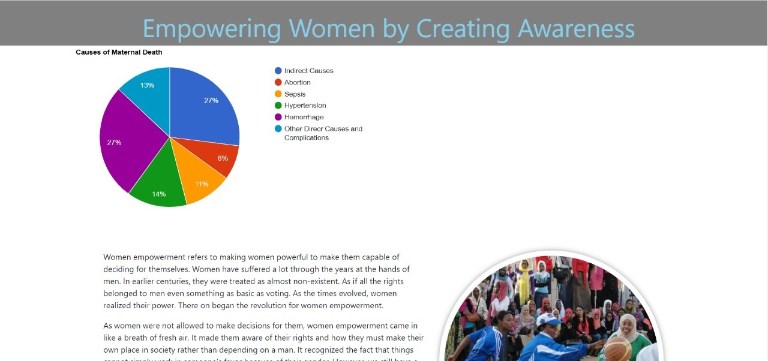
Need for women empowerment
In this contemporary world, women need to gain same amount of power that men have..
Women should forget that men are holders of power.
They are backbone of this society.
Women should be empowered in different sections like education,politics work force and even more within their households
They play the most important role of keeping the family together..

Slide 6
Importance of women empowerment
Women ARE leaders everywhere you look a ceo to housewife that holds together a home. Our country was built by women who stands alone.
Empowered women can exert power to shape their families, ccommunities and countries.
Women should be respected as well as her needs and aspirations as she can only give best to this society

Slide 7
Benefits to societyby our website by women empowerment
Personal knowledge
Self-independent
personal power
authenticity
Creativity
Economic independence
Having political power in society

Slide 8
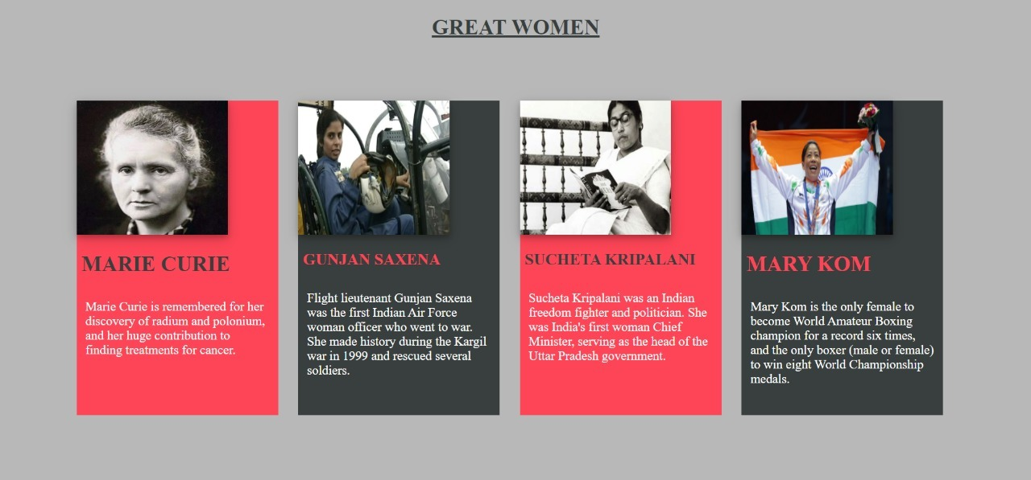

Slide 9
Contributors of this project:-
Team pulverizers
Tools used by the team :-
1. Gaurav gupta
2. kashish choudhary
3. chandan sharma
4.tushar jain
5.prince sharma
6.tarandeep singh
1.html
2.css
3.python
4.vs code
5.php with future possibilities….

Slide 10
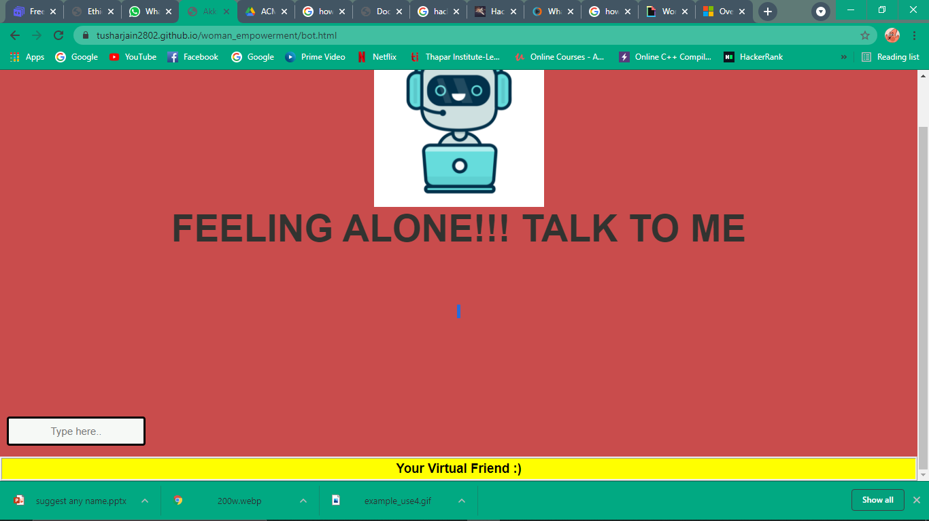
A VIRTUAL CHAT BOT
WE HAVE ALSO INCLUDED chatbots that can answer questions posed by our visitors to your website.
WE ARE WORKING ON IT AND TRYING TO ADD NEW FEATURES IN IT SO THAT IT CAN OUR VISITORS TO SOLVE THEIR EACH AND EVERY QUERY.

Slide 11
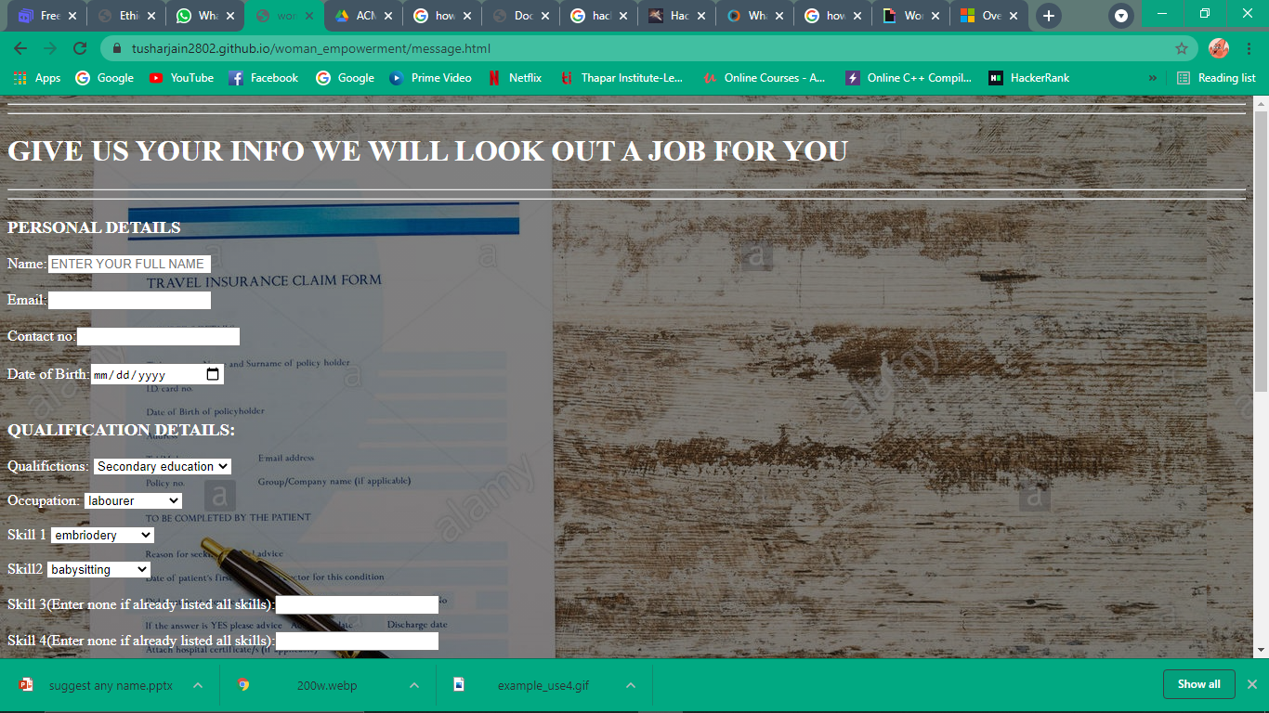
SELF INDEPENDDENT
IF ANY VISITOR WANTS TO DEVELOP SKILLS OR IS FINDING A PLACE TO WORK SO THAT SHE CAN BE INDEPENDENT CAN FILLS HER DETAILS IN OUR PAGE AND HE WILL BE HELPING IN HER TO DEVELOP NEW SKILLS AND PROVIDE HER THE BEST JOB AS PER HER SKILLS.

Slide 12
THANK YOU
☺

